Slide 1




Loops, Methods, Classes
Using Loops, Defining and Using Methods, Using API Classes, Exceptions, Defining Classes
Angel Georgiev
Part-time Trainer
Software University
http://softuni.bg

Slide 2


Table of Contents
Loops
while, do-while, for, for-each
Methods
Defining Methods
Invoking Methods
Using the Java API Classes
Exception Handling Basics
Defining Simple Classes

Slide 3


Warning: Not for Absolute Beginners
The "Java Basics" course is NOT for absolute beginners
Take the "C# Basics" course at SoftUni first: https://softuni.bg/courses/csharp-basics
The course is for beginners, but with previous coding skills
Requirements
Coding skills – entry level
Computer English – entry level
Logical thinking
coding skills
required!

Slide 4



Loops

Slide 5

Loop: Definition
A loop is a control statement that repeats the execution of a block of statements
May execute a code block fixed number of times
May execute a code block while given condition holds
May execute a code block for each member of a collection
Loops that never end are called an infinite loops
while (condition) {
statements;
}

Slide 6
While Loop
The simplest and most frequently used loop
The repeat condition
Returns a boolean result of true or false
Also called loop condition
while (condition) {
statements;
}

Slide 7
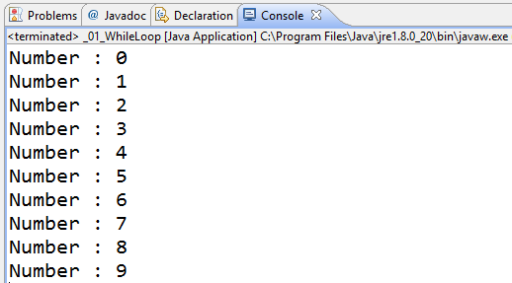
While Loop – Example: Numbers 0…9
int counter = 0;
while (counter < 10) {
System.out.printf("Number : %d\n", counter);
counter++;
}

Slide 8
Do-While Loop
Another classical loop structure is:
The block of statements is repeated
While the boolean loop condition holds
The loop is executed at least once
do {
statements;
}
while (condition);

Slide 9
Product of Numbers [N..M] – Example
Calculating the product of all numbers in the interval [n..m]:
Scanner input = new Scanner(System.in);
int n = input.nextInt();
int m = input.nextInt();
int number = n;
BigInteger product = BigInteger.ONE;
do {
BigInteger numberBig = new BigInteger("" + number);
product = product.multiply(numberBig);
number++;;
}
while (number <= m);
System.out.printf("product[%d..%d] = %d\n", n, m, product);

Slide 10
For Loops
The classical for-loop syntax is:
Consists of
Initialization statement
Boolean test expression
Update statement
Loop body block
for (initialization; test; update) { statements; }

Slide 11
For Loop – Examples
A simple for-loop to print the numbers 0…9:
for (int number = 0; number < 10; number++) {
System.out.print(number + " ");
}
A simple for-loop to calculate n!:
long factorial = 1;
for (int i = 1; i <= n; i++) {
factorial *= i;
}

Slide 12
Using the continue Operator
continue bypasses the iteration of the inner-most loop
Example: sum all odd numbers in [1…n], not divisors of 7:
int n = 100;
int sum = 0;
for (int i = 1; i <= n; i += 2) {
if (i % 7 == 0) {
continue;
}
sum += i;
}
System.out.println("sum = " + sum);

Slide 13
Using the break Operator
The break operator exits the inner-most loop
public static void main(String[] args) {
int n = new Scanner(System.in).nextInt();
// Calculate n! = 1 * 2 * ... * n
int result = 1;
while (true) {
if (n == 1)
break;
result *= n;
n--;
}
System.out.println("n! = " + result);
}

Slide 14
For-Each Loop
The typical for-each loop syntax is:
Iterates over all the elements of a collection
The element is the loop variable that takes sequentially all collection values
The collection can be list, array or other group of elements of the same type
for (Type element : collection) { statements; }

Slide 15
For-Each Loop – Example
Example of for-each loop:
The loop iterates over the array of day names
The variable day takes all its values
Applicable for all collections: arrays, lists, strings, etc.
String[] days = { "Monday", "Tuesday", "Wednesday",
"Thursday", "Friday", "Saturday", "Sunday" };
for (String day : days) {
System.out.println(day);
}

Slide 16
Nested Loops
Loops can be nested (one inside another)
Example: print all combinations from TOTO 6/49 lottery
for (int i1 = 1; i1 <= 44; i1++)
for (int i2 = i1 + 1; i2 <= 45; i2++)
for (int i3 = i2 + 1; i3 <= 46; i3++)
for (int i4 = i3 + 1; i4 <= 47; i4++)
for (int i5 = i4 + 1; i5 <= 48; i5++)
for (int i6 = i5 + 1; i6 <= 49; i6++)
System.out.printf("%d %d %d %d %d %d\n",
i1, i2, i3, i4, i5, i6);

Slide 17

Loops
Live Demo

Slide 18
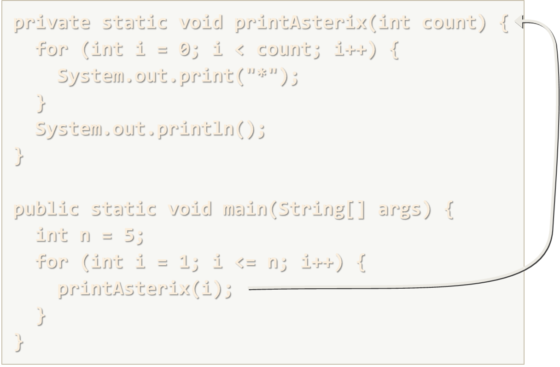
Methods
Defining and Invoking Methods

Slide 19
Methods: Defining and Invoking
Methods are named pieces of code
Defined in the class body
Can be invoked multiple times
Can take parameters
Can return a value
private static void printAsterix(int count) {
for (int i = 0; i < count; i++) {
System.out.print("*");
}
System.out.println();
}
public static void main(String[] args) {
int n = 5;
for (int i = 1; i <= n; i++) {
printAsterix(i);
}
}

Slide 20
Methods with Parameters and Return Value
static double calcTriangleArea(double width, double height) {
return width * height / 2;
}
public static void main(String[] args) {
Scanner input = new Scanner(System.in);
System.out.print("Enter triangle width: ");
double width = input.nextDouble();
System.out.print("Enter triangle height: ");
double height = input.nextDouble();
System.out.println("Area = " + calcTriangleArea(width, height));
}
Method names in Java should be in camelCase

Slide 21
Recursion
Recursion == method can calls itself
public static void main(String[] args) {
int n = 5;
long factorial = calcFactorial(n);
System.out.printf("%d! = %d", n, factorial);
}
private static long calcFactorial(int n) {
if (n <= 1) {
return 1;
}
return n * calcFactorial(n-1);
}

Slide 22
Method Return Types
Type void
Does not return a value directly by itself
Other types
Return values, based on the return type of the method
static void addOne(int n) {
n += 1;
System.out.println(n);
}
static int plusOne(int n) {
return n + 1;
}

Slide 23
Method Access Modifiers
private
Accessible only inside the current class. No subclass can call this
package (default)
Accessible only inside the package. Subclasses can call this
protected
Accessible by subclasses even outside the current package
public
All code can access this, e.g. external classes

Slide 24
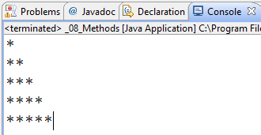
Methods
Live Demo

Slide 25

Using the Java API Classes

Slide 26
Build-in Classes in the Java API
Java SE provides thousands of ready-to-use classes
Located in packages like java.lang, java.math, java.net, java.io, java.util, java.util.zip, etc.
Using static Java classes:
Using non-static Java classes
LocalDate today = LocalDate.now();
double cosine = Math.cos(Math.PI);
Random rnd = new Random();
int randomNumber = 1 + rnd.nextInt(100);

Slide 27
Using the Java API Classes
Live Demo

Slide 28

Exception Handling Basics
Catch and Throw Exceptions

Slide 29

Handling Exceptions
In Java exceptions are handled by the try-catch-finally construction
catch blocks can be used multiple times to process different exception types
try {
// Do some work that can raise an exception
} catch (SomeException ex) {
// Handle the caught exception
} finally {
// This code will always execute
}

Slide 30

Handling Exceptions – Example
public static void main(String[] args) {
String str = new Scanner(System.in).nextLine();
try {
int i = Integer.parseInt(str);
System.out.printf(
"You entered a valid integer number %d.\n", i);
}
catch (NumberFormatException nfex) {
System.out.println("Invalid integer number: " + nfex);
}
}

Slide 31
The "throws …" Declaration
A method in Java could declare "throws SomeException"
This says "I don't care about SomeException", please re-throw it
public static void copyStream(InputStream inputStream,
OutputStream outputStream) throws IOException {
byte[] buf = new byte[4096]; // 4 KB buffer size
while (true) {
int bytesRead = inputStream.read(buf);
if (bytesRead == -1)
break;
outputStream.write(buf, 0, bytesRead);
}
}

Slide 32
Resource Management in Java
When we use a resource that is expected to be closed, we use the try-with-resources statement
try(
BufferedReader fileReader = new BufferedReader(
new FileReader("somefile.txt"));
) {
while (true) {
String line = fileReader.readLine();
if (line == null) break;
System.out.println(line);
} catch (IOException ioex) {
System.err.println("Cannot read the file ".);
}

Slide 33
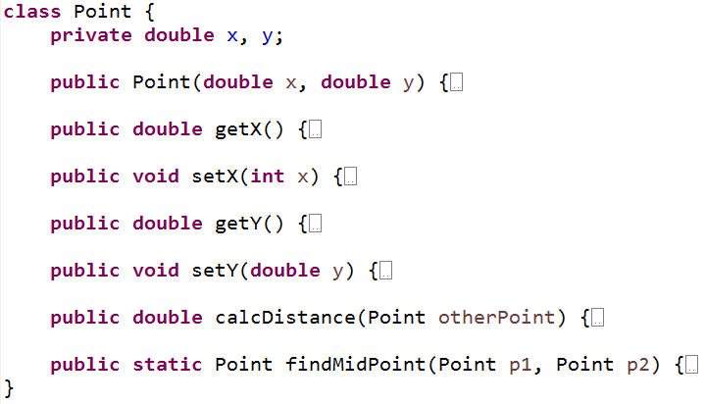
Defining Simple Classes
Using Classes to Hold a Set of Fields

Slide 34
Defining Classes in Java
Classes in Java combine a set of named fields / properties
Defining a class Point holding X and Y coordinates:
class Point {
private int x, y;
public Point(int x, int y) {
this.x = x;
this.y = y;
}
public int getX() {
return x;
}
public void setX(int x) {
this.x = x;
}
public int getY() { … }
public void setY(int y) { … }
}

Slide 35
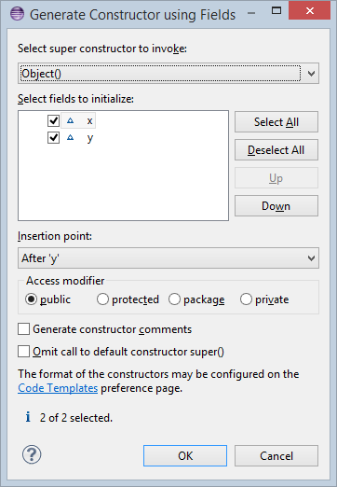
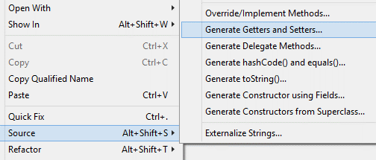
Defining Classes in Eclipse
Eclipse provides tools for automatic generation of constructors and getters / setters for the class fields

Slide 36
Defining Simple Classes
Live Demo

Slide 37

Summary
Java supports the classical loop constructs
while, do-while, for, for-each
Similarly to C#, JavaScript, PHP, C, C++, …
Java support methods
Methods are named code blocks
Can take parameters and return a result
Java supports classical exception handling
Through the try-catch-finally construct
Developers can define their own classes
With fields, methods, constructors, getters, setters, etc.

Slide 38
Loops, Methods, Classes
https://softuni.bg/courses/java-basics/

Slide 39
License
This course (slides, examples, demos, videos, homework, etc.) is licensed under the "Creative Commons Attribution-NonCommercial-ShareAlike 4.0 International" license
Attribution: this work may contain portions from
"Fundamentals of Computer Programming with Java" book by Svetlin Nakov & Co. under CC-BY-SA license
"C# Basics" course by Software University under CC-BY-NC-SA license

Slide 40







SoftUni Diamond Partners

Slide 41





Free Trainings @ Software University
Software University Foundation – softuni.org
Software University – High-Quality Education, Profession and Job for Software Developers
softuni.bg
Software University @ Facebook
facebook.com/SoftwareUniversity
Software University @ YouTube
youtube.com/SoftwareUniversity
Software University Forums – forum.softuni.bg

